Slide 1
Summarization

Slide 2
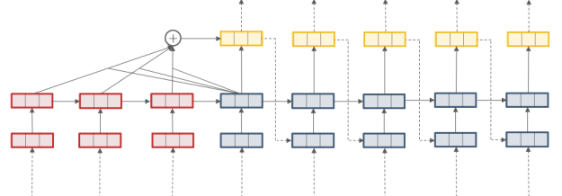
Practice 2
Document Summarization
Source Text ➔ Summary
RNN Encoder-Decoder Model + Attention (Same as Translation Model)
Data Set
CNN Daily
Summary
Source Text

Slide 3
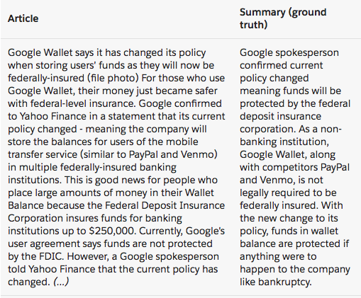
Practice 2
Dataset
Cnn Daily data
CNN / Daily Mail summarization dataset
Data Format
홀수번째 줄: 원문
짝수번째 줄: 요약문
Document 1\n
Sumamry 1\n
Document 2\n
Summary 2\n
.
.
.
Docuement n\n
Summary n\n

Slide 4
Practice 2: Summarization
Preprocessing
Load Vocab data
def read_vocab(self): # with open(self.path + 'vocab', 'r', encoding='utf-8') as fvocab: # python 3 with open(self.path + 'vocab', 'r', encoding='UTF-8') as fvocab: lines = fvocab.readlines() for line in lines: word = line.rstrip().split()[0] if word not in self.w2idx: self.w2idx[word] = len(self.w2idx) if len(self.w2idx) == self.enc_vocab: break print(' | Read vocab: {} - {:.2f}s'.format(len(self.w2idx), time.time()-self.start_time))

Slide 5
Practice 2: Summarization
Preprocessing
Load Text data
홀수번째 줄: 원문
짝수번째 줄: 요약문
def read_text(self): # with open(self.path+'train.enc_dec', 'r', encoding='utf-8') as fin: with open(self.path + 'train.enc_dec', 'r', encoding='UTF-8') as fin: train_lines = fin.readlines() # with open(self.path+'test.enc_dec', 'r', encoding='utf-8') as fin: with open(self.path + 'test.enc_dec', 'r', encoding='UTF-8') as fin: test_lines = fin.readlines() text = train_lines + test_lines n1, n2 = int(len(train_lines)/2), int(len(test_lines)/2) self.train_idx = list(np.arange(0, n1)) self.test_idx = list(np.arange(n1, n1+n2)) print(' | info. {} {}'.format(n1, n2)) print(' | Read text: {} - {:.2f}s'.format(n1+n2, time.time() - self.start_time)) return text, n1+n2

Slide 6
Practice 2: Summarization
Preprocessing
Build data
def build_data(self): enc_ids = np.zeros((self.size, self.enc_len), dtype=np.int32) dec_ids = np.zeros((self.size, self.dec_len), dtype=np.int32) length = np.zeros((self.size, 2), dtype=np.int32) idx = 0 for i in range(0, self.size*2, 2): self.text[i] += ' <eos>' self.text[i+1] += ' <eos>' enc = self.text[i].split() dec = self.text[i+1].split() length[idx][0] = min(len(enc), self.enc_len) length[idx][1] = min(len(dec), self.dec_len) dec_cnt = 0 for j in range(length[idx][0]): enc_ids[idx][j] = self.word2idx(enc[j], self.enc_vocab) # 데이터에 있는 문장의 시작, 끝(<s>, '</s>')를 제거 for j in range(length[idx][1]): if dec[j] != '<s>' and dec[j] != '</s>': dec_ids[idx][dec_cnt] = self.word2idx(dec[j], self.dec_vocab) dec_cnt += 1 length[idx][1] = dec_cnt idx += 1 return enc_ids, dec_ids, length

Slide 7
Practice 2: Summarization
Preprocessing (Mini-Batch)
Code
def get_batch(self, mode, batch_size): if mode is 'train': idx = random.sample(self.train_idx, batch_size) else: idx = random.sample(self.test_idx, batch_size) return idx, self.enc_ids[idx], self.dec_ids[idx], self.length[idx, 0], self.length[idx, 1]

Slide 8
Practice 2: Summarization
Preprocessing
Data Information
print(' | Size: {}, {}'.format(self.train_size, self.test_size)) print(' | Vocab: {}'.format(len(self.w2idx))) print(' | Avg length: {:.1f} / {:.1f} words'.format(self.length.mean(0)[0], self.length.mean(0)[1])) print(' | Building time: {:.2f}s'.format(time.time() - self.start_time)) print(' *---- Dataset Intialized ----\n')
| path: ./dataset/cnn_daily
| Load data: ./test_s.npy
| Size: 13368, 11490
| Vocab: 50000
| Avg length: 383.8 / 58.7 words
| Building time: 0.28s

Slide 9
Practice 2: Summarization
Initialize variable
def init_placeholder(self): # word embedding self.emb_W_enc = self.get_var(name='emb_W_enc', shape=[self.enc_vocab, self.emb_dim]) self.emb_W_dec = self.get_var(name='emb_W_dec', shape=[self.dec_vocab, self.emb_dim]) # encoder part self.x = tf.placeholder(dtype=tf.int32, shape=(None, self.enc_len)) self.x_len = tf.placeholder(dtype=tf.int32, shape=(None,)) self.x_emb = tf.nn.embedding_lookup(self.emb_W_enc , self.x) self.batch_size = tf.shape(self.x)[0] # decoder part self.y = tf.placeholder(dtype=tf.int32, shape=(None, self.dec_len)) self.y_len = tf.placeholder(dtype=tf.int32, shape=(None,)) self.y_emb = tf.concat([tf.nn.embedding_lookup(self.emb_W_dec, tf.zeros([self.batch_size, 1], dtype=tf.int32)), tf.nn.embedding_lookup(self.emb_W_dec, self.y)], axis=1)

Slide 10
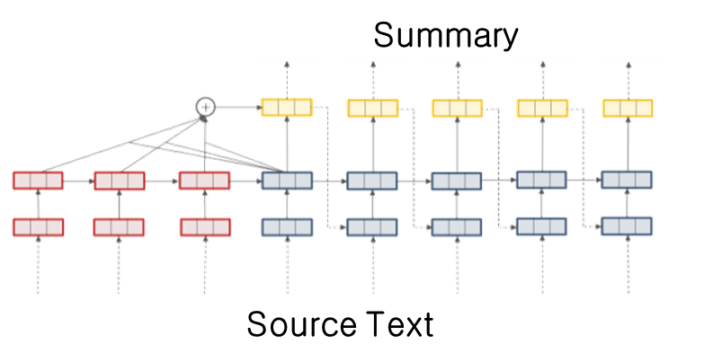
Practice 2: Summarization
Setup Layers (Model)
Encoder
Sentence Embedding Model
Decoder
Add Attention Model

Slide 11
Practice 2: Summarization
Setup Layers (Model)
Code
def rnn_encode(self): (self.enc_out, (fw_state, bw_state)) = bidirectional_dynamic_rnn( LSTMCell(self.hidden_dim), LSTMCell(self.hidden_dim), inputs=self.x_emb, sequence_length=self.x_len, dtype=tf.float32) self.enc_out = tf.concat(self.enc_out, 2) decoder_init_c = Dense(self.hidden_dim, dtype=tf.float32, name='decoder_c', activation=tf.nn.tanh) decoder_init_h = Dense(self.hidden_dim, dtype=tf.float32, name='decoder_h', activation=tf.nn.tanh) self.init_state = LSTMStateTuple(decoder_init_c(tf.concat([fw_state.c, bw_state.c], 1)), decoder_init_h(tf.concat([fw_state.h, bw_state.h], 1)))

Slide 12
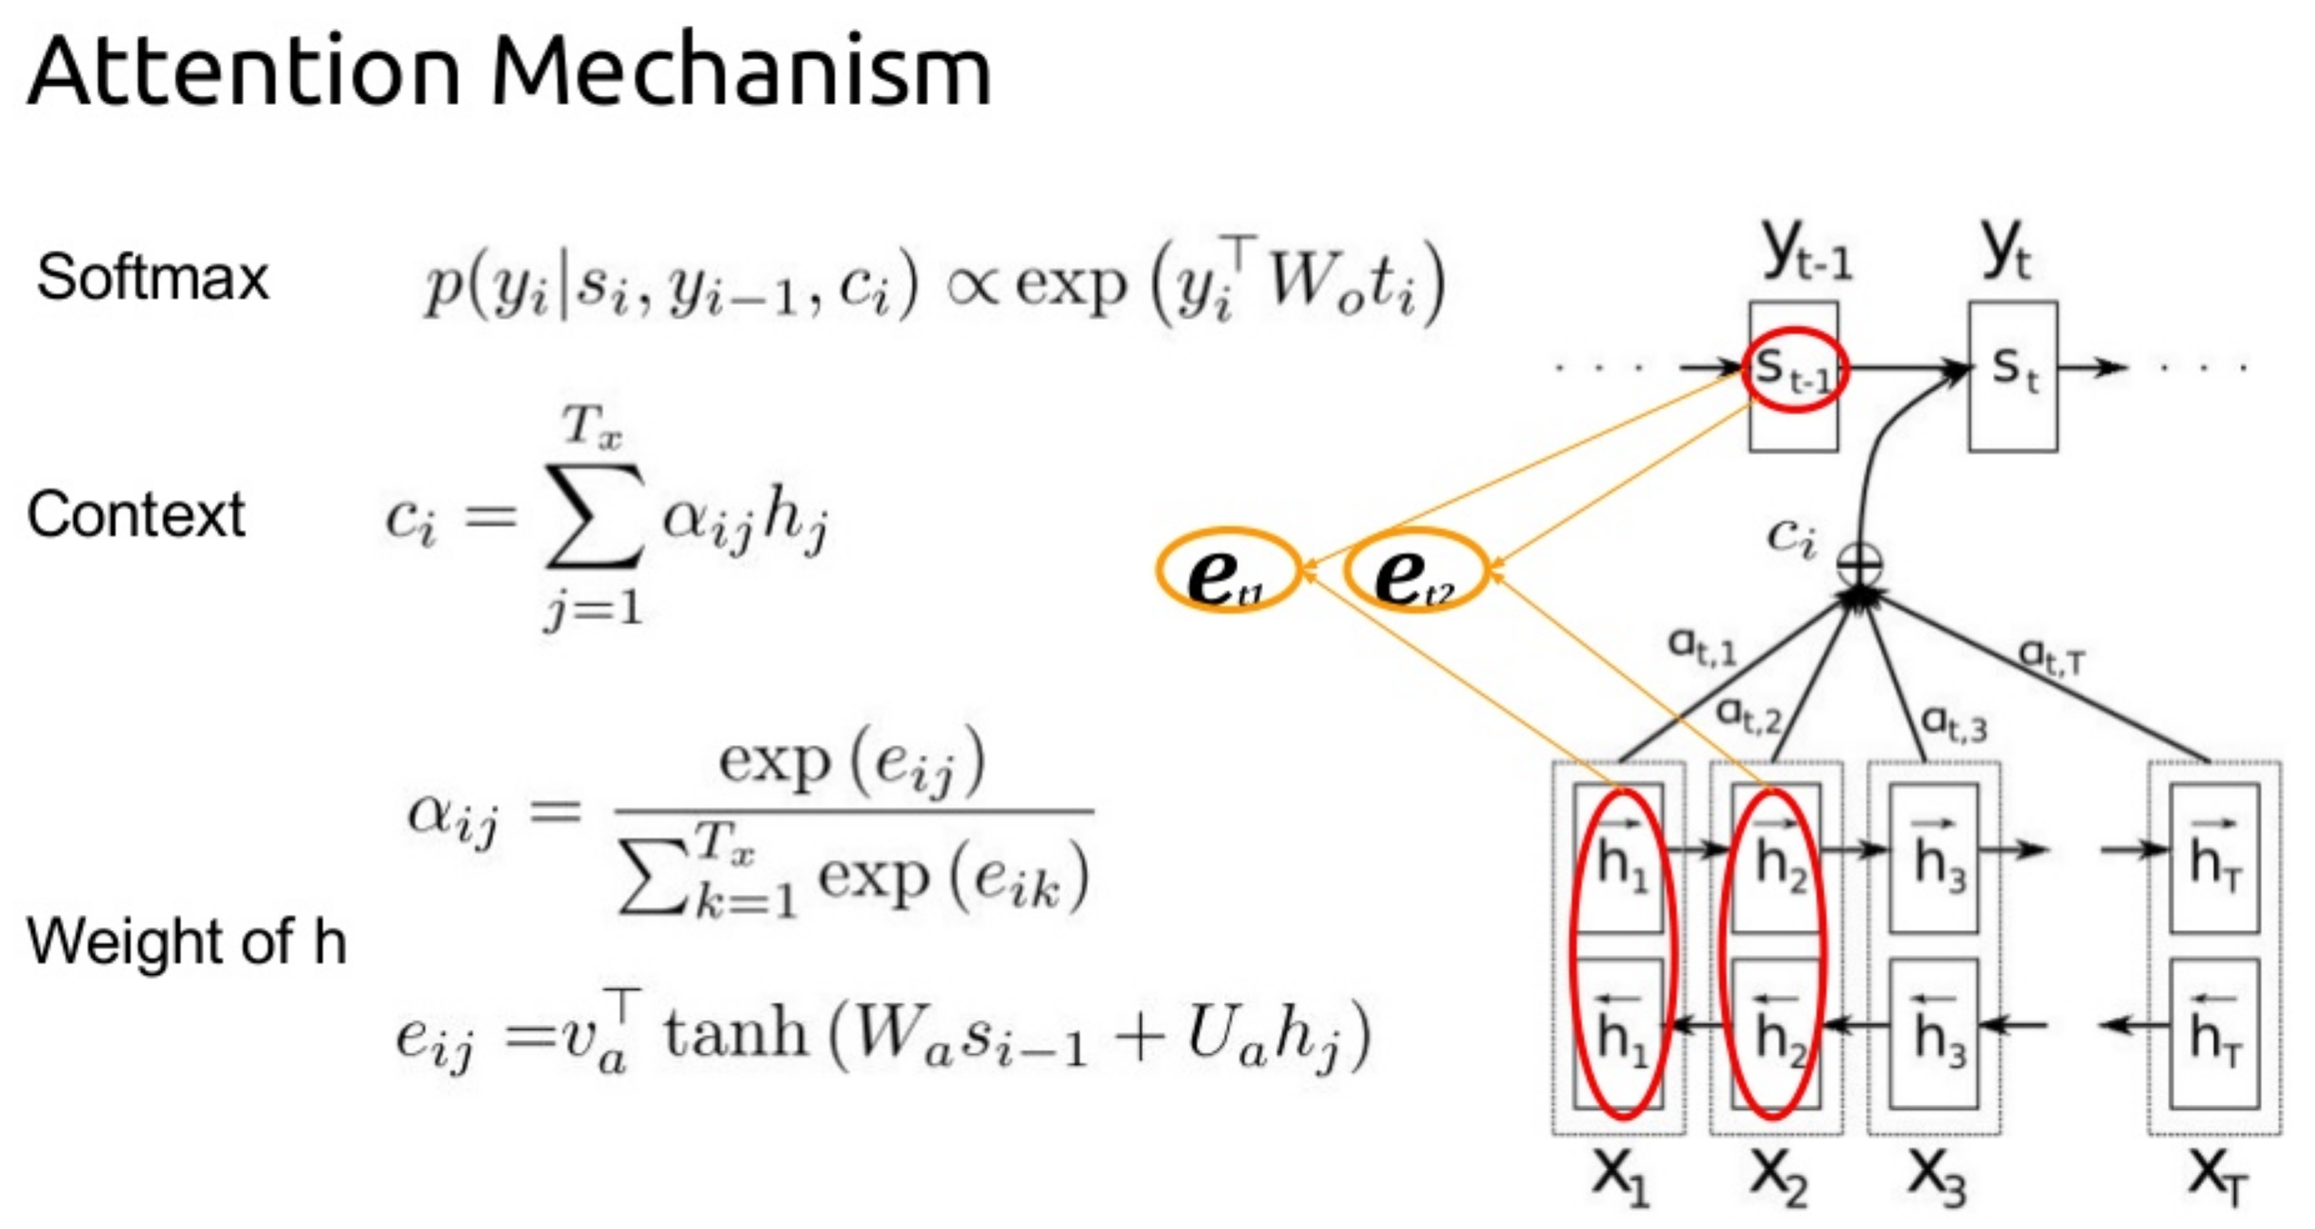
Practice 2: Summarization
Setup Layer (Model)
def init_enc_attention(self): # self.hidden_dim = 300 # defined at init self.attWe = self.get_var(name='attnW_et', shape=[1, 1, self.hidden_dim, self.hidden_dim]) self.attve = self.get_var(name='attnV_et', shape=[self.hidden_dim, 1]) self.attUe = self.get_var(name='attnU_et', shape=[1, 1, self.hidden_dim * 2, self.hidden_dim]) self.attbe = self.get_var(name='attnB_et', shape=[self.hidden_dim]) att_e = tf.nn.conv2d(tf.reshape(self.enc_out, [-1, self.enc_len, 1, self.hidden_dim * 2]), filter=self.attUe, strides=[1, 1, 1, 1], padding='VALID') self.attUeh = tf.reshape(att_e + self.attbe, [-1, self.hidden_dim])

Slide 13
Practice 2: Summarization
Setup Layer (Model)
# Encoder attention softmax def encoder_attention(self, state): # decoder state st = tf.reshape(tf.tile(state, [1, self.enc_len]), [-1, self.enc_len, 1, self.hidden_dim]) attWes = tf.reshape(tf.nn.conv2d(st, filter=self.attWe, strides=[1, 1, 1, 1], padding='SAME'), [-1, self.hidden_dim]) # encoder attention distribution (logit) e_t = tf.reshape(tf.matmul(tf.nn.tanh(attWes + self.attUeh), self.attve), [-1, self.enc_len]) * self.enc_masks return tf.nn.softmax(e_t)

Slide 14
Practice 2: Summarization
Setup Layer (Model)
def decode_train(self): y_emb_tbd = tf.transpose(self.y_emb, [1, 0, 2]) arr_prob = tf.TensorArray(dtype=tf.float32, size=self.dec_len) def body(step, state, arr_prob): enc_softmax = self.encoder_attention(state.h) context_vector = tf.reduce_sum(self.enc_out * tf.expand_dims(enc_softmax, -1), axis=1) word_prob = tf.nn.softmax(self.out_layer(tf.concat([state.h, context_vector], 1))) arr_prob = arr_prob.write(step, word_prob) next_input = tf.concat([y_emb_tbd[step + 1], context_vector], 1) next_out, next_state = self.decoder_cell(next_input, state) return step+1, next_state, arr_prob _step, _state, _arr_prob = tf.while_loop( cond=lambda t, _1, _2: t < self.dec_len, body=body, loop_vars=(0, self.init_state, arr_prob)) self.train_prob = tf.transpose(_arr_prob.stack(), perm=[1, 0, 2])

Slide 15
Practice 2: Summarization
Setup Layer (Model)
def decode_infer(self): arr_token = tf.TensorArray(dtype=tf.int32, size=self.dec_len) def body(step, state, arr_token): enc_softmax = self.encoder_attention(state.h) context_vector = tf.reduce_sum(self.enc_out * tf.expand_dims(enc_softmax, -1), axis=1) word_prob = tf.nn.softmax(self.out_layer(tf.concat([state.h, context_vector], 1))) # Write token next_token = tf.cast(tf.reshape(tf.argmax(word_prob, 1), [self.batch_size]), tf.int32) arr_token = arr_token.write(step, next_token) token_emb = tf.nn.embedding_lookup(self.emb_W_dec, next_token) next_input = tf.concat([token_emb, context_vector], 1) next_out, next_state = self.decoder_cell(next_input, state) return step+1, next_state, arr_token _step, _state, _arr_token = tf.while_loop( cond=lambda t, _1, _2: t < self.dec_len, body=body, loop_vars=(0, self.init_state, arr_token)) self.test_token = tf.transpose(_arr_token.stack(), perm=[1, 0])

Slide 16
Practice 2: Summarization
Setup Layers (Model)
Code
self.rnn_encode() self.init_enc_attention() self.decoder_cell = LSTMCell(self.hidden_dim, state_is_tuple=True) self.out_layer = Dense(self.dec_vocab, dtype=tf.float32, name='out_layer') self.decode_train() self.decode_infer() # Define loss & optimizer self.build_loss() self.build_opt()

Slide 17
Practice 2: Summarization
Build Loss
Code
Build Optimizer
Code
# cross-entropy loss self.cross_entropy = -tf.reduce_sum( tf.one_hot(tf.to_int32(tf.reshape(self.y, [-1])), self.dec_vocab, 1.0, 0.0) * tf.log(tf.clip_by_value(tf.reshape(self.train_prob, [-1, self.dec_vocab]), 1e-20, 1.0)), 1) self.loss = tf.reduce_sum(self.cross_entropy * tf.reshape(self.dec_masks, [-1])) / self.dec_mask_sum tf.summary.scalar('loss', self.loss)
def build_opt(self): opt_adam = tf.train.AdamOptimizer(learning_rate=self.learning_rate) optimizer = opt_adam def clipped_grad(grad): return [None if g is None else tf.clip_by_norm(g, 2.5) for g in grad] # compute gradient & clipping grad, var = zip(*optimizer.compute_gradients(self.loss)) if self.use_clip: grad = clipped_grad(grad) # update weights self.update = optimizer.apply_gradients(zip(grad, var))

Slide 18
Practice 2: Summarization
Train Model
Code
def train_model(sess, model, data): print(' . Start training - batch_size: {}'.format(BATCH_SIZE)) global min_it, min_loss cur_time = time.time() avg_loss, loss_cov, avg_cov, loss_attn, avg_attn = .0, .0, .0, .0, .0 it_log, it_test, it_save = 10, 100, 1000 idxs = [i for i in range(0, data.train_size)] random.shuffle(idxs) for it in range(1, 10000): idx, enc, dec, enc_len, dec_len = data.get_batch('train', BATCH_SIZE) feed_dict = {model.x: enc, model.x_len: enc_len, model.y: dec, model.y_len: dec_len} loss, _, = sess.run([model.loss, model.update], feed_dict=feed_dict) avg_loss+=loss if it % it_log is 0: log_str = "{:5d} : {:.4f}- {:.2f}s".format(it, avg_loss / it_log, time.time() - cur_time) print(log_str) avg_loss, cur_time = .0, time.time() if it % it_save is 0 and it: model.save_model(sess, 'saved_models/') if it % it_test is 0 and it: test_model(sess, model, data, 'test')

Slide 19
Practice 2: Summarization
Test Model and Result
Metric
ROUGE n-gram based measure
Overlapped n-grams between generated summary and original summary – Precision/Recall/F-measure
ROUGE-1 : uni-grams
ROUGE-2 : bi-grams
ROUGE-L : Longest matching sequence

Slide 20

Practice 2: Summarization
the cat
cat was
was found
found under
under the
the bed
Test Model and Result
ROUGE example
System output
Reference
Rouge-1 Precision = $\frac{6}{7}$
Rouge-1 Recall = $\frac{6}{6}$
Rouge-2 Precision = $\frac{4}{6}$
Rouge-2 Recall = $\frac{4}{5}$
the cat was found under the bed
the cat was under the bed
the cat
cat was
was under
under the
the bed

Slide 21
Practice 2: Summarization
Test Model and Result (ROUGE-N)
Code
def rouge2str(score, mode): return '{}_p - rouge-1: {:.4f} | rouge-2: {:.4f} | rouge-L: {:.4f} | \n' \ '{}_r - rouge-1: {:.4f} | rouge-2: {:.4f} | rouge-L: {:.4f} | \n' \ '{}_f - rouge-1: {:.4f} | rouge-2: {:.4f} | rouge-L: {:.4f}'.\ format(mode, score['rouge-1']['p'], score['rouge-2']['p'], score['rouge-l']['p'], mode, score['rouge-1']['r'], score['rouge-2']['r'], score['rouge-l']['r'], mode, score['rouge-1']['f'], score['rouge-2']['f'], score['rouge-l']['f'])
def toRougeStr(data, line, words, ref=False): text = "" if type(line) != str: line = ids2text(data, line) cnt = 0 for i, word in enumerate(line.split()): if word == "<eos>" or cnt==data.dec_len: break elif word == "</s>" and ref==True: text += "\n" elif word == "." and ref==False: text += ". \n" elif word != "<s>": text += word + " " cnt += 1 return text.rstrip()

Slide 22
Practice 2: Summarization
Test Model and Result
Code
def test_model(sess, model, data, mode="test"): start_time = time.time() avg_loss, ref, hyp = .0, [], [] it_size = 10 for it in range(it_size): idx, enc, dec, enc_len, dec_len = data.get_batch("test", BATCH_SIZE) feed_dict = {model.x: enc, model.x_len: enc_len, model.y: dec, model.y_len: dec_len} loss, token = sess.run([model.loss, model.test_token], feed_dict=feed_dict) avg_loss += loss for i in range(BATCH_SIZE): ref.append(toRougeStr(data, data.text[idx[i]*2+1], True)) hyp.append(toRougeStr(data, token[i], False)) print('{} batches - test loss: {:.3f} '.format(it_size, avg_loss/it_size)) print(u"ref\n" + ref[0]) print(u"hyp\n" + hyp[0]) rouge_score = Rouge_score(hyp, ref, avg=True) score_str = rouge2str(rouge_score, mode) + ' | {:.2f}s\n'.format(time.time() - start_time) print(score_str)

Slide 23
Practice 2: Summarization
Result
5210 : 4.5489- 25.57s
5220 : 4.5224- 15.00s
5230 : 4.4477- 15.06s
5240 : 4.3907- 15.02s
5250 : 4.4214- 14.97s
10 batches - test loss: 5.865
ref
property developer falsely accused neighbour 's son-in-law of racist assault .
</s> sanjay chaddah said he was called a ` p ** i ' during dispute with dean paton .
</s> but police found cctv footage that showed in fact he attacked mr paton .
</s> yesterday chaddah was given suspended sentence for assault and perjury .
</s> he punched the air with delight and smirked as he strolled free from court .
</s>
hyp
<unk> <unk> , 37 , was jailed for a <unk> in the <unk> .
he was jailed for a <unk> man in the ground in the incident .
he was jailed for a <unk> , but he was jailed for a <unk> .
test_p - rouge-1: 0.3614 | rouge-2: 0.0407 | rouge-L: 0.3434 |
test_r - rouge-1: 0.1104 | rouge-2: 0.0145 | rouge-L: 0.1051 |
test_f - rouge-1: 0.1640 | rouge-2: 0.0206 | rouge-L: 0.1126 | 10.56s

